Slide 1
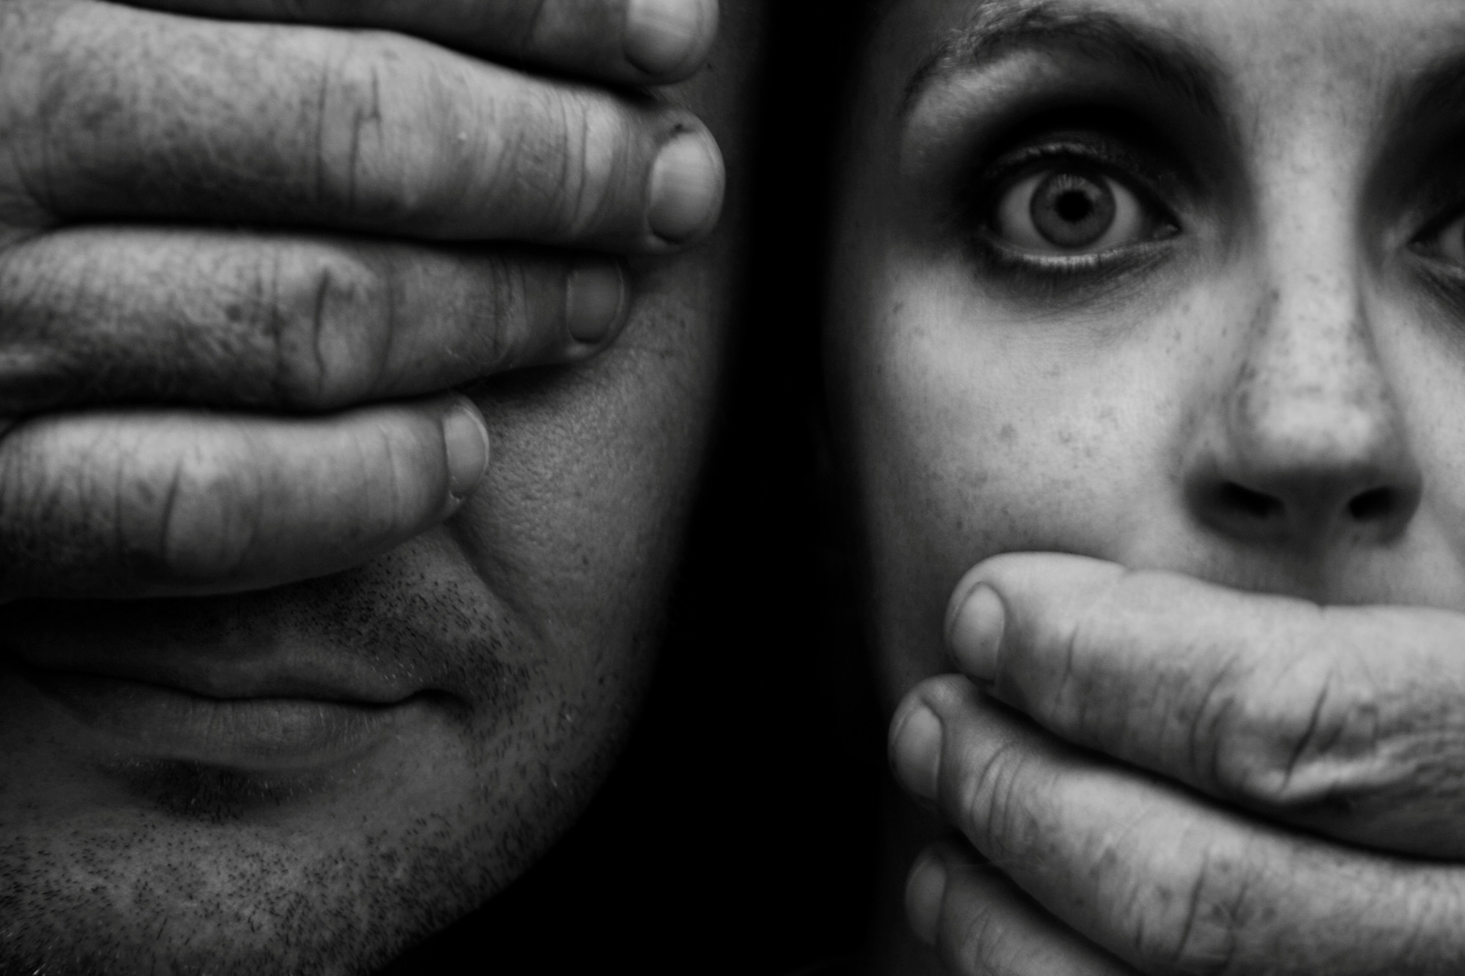
ECUADOR
THE COMMUNICATIONS LAW & ITS CONSEQUENCES
THE GAG LAW
JAIME MANTILLA A.
mantillajaime3@gmail.com
@ jaimemantilla
HARVARD UNIVERSITY
April, 7, 2016
Notes:
I want to thank Harvard University’s Ecuadorean student association, a center for excellence, knowledge & debate; Mr. Jose Valencia; and all of those who made possible my presence here today to share with you my experience, gathered over 50 years of working in journalism and communications.
I am not an academic. I have been a journalist and media entrepreneur. I have lived first hand the challenges that this ancient craft of reporting, analyzing, building a point of view, determining the implications that events have on our daily life, and mostly giving a voice to the people.

Slide 2

Is journalism dying?
Are digital media and social networks taking its place?
NO!!!
Notes:
Many people think that Journalism is on its way out, that soon it will disappear; that the growth of digital and social media will mean the end of Journalism as we know it.
I do not believe so.

Slide 3

Social networks are overwhelmed with information without context and usually false.
There is a need for GOOD journalists and GREAT editors.
Notes:
While social networks have changed the way we now access information, they have overwhelming amounts of sometimes even false data; they lack the necessary context to make that information a useful tool for society and they dilute the credibility of its sources. I strongly believe that we will always need the interpretation and contextualization of a journalist, an expert editor, that as Kapuscinski said has to be above everything “a person of integrity”.

Slide 4
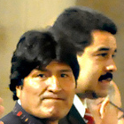
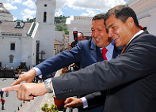
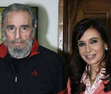


POWERFUL GROUPS try to “control” information
Authoritarian Governments need to do it imposing the “ONLY OFFICIAL TRUTH”
Notes:
In their desire to control what people think, over powerful governments will look for ways that will destroy the credibility of independent media. They will create media of their own to impose their official truth and find ways to destroy whatever in their mind threatens their power. And in today’s hyper connected world, they will abuse the power of social channels without taking into consideration the impact that information could have on those communities, connected through technology but with ideas, experiences and realities completely different from each other.

Slide 5
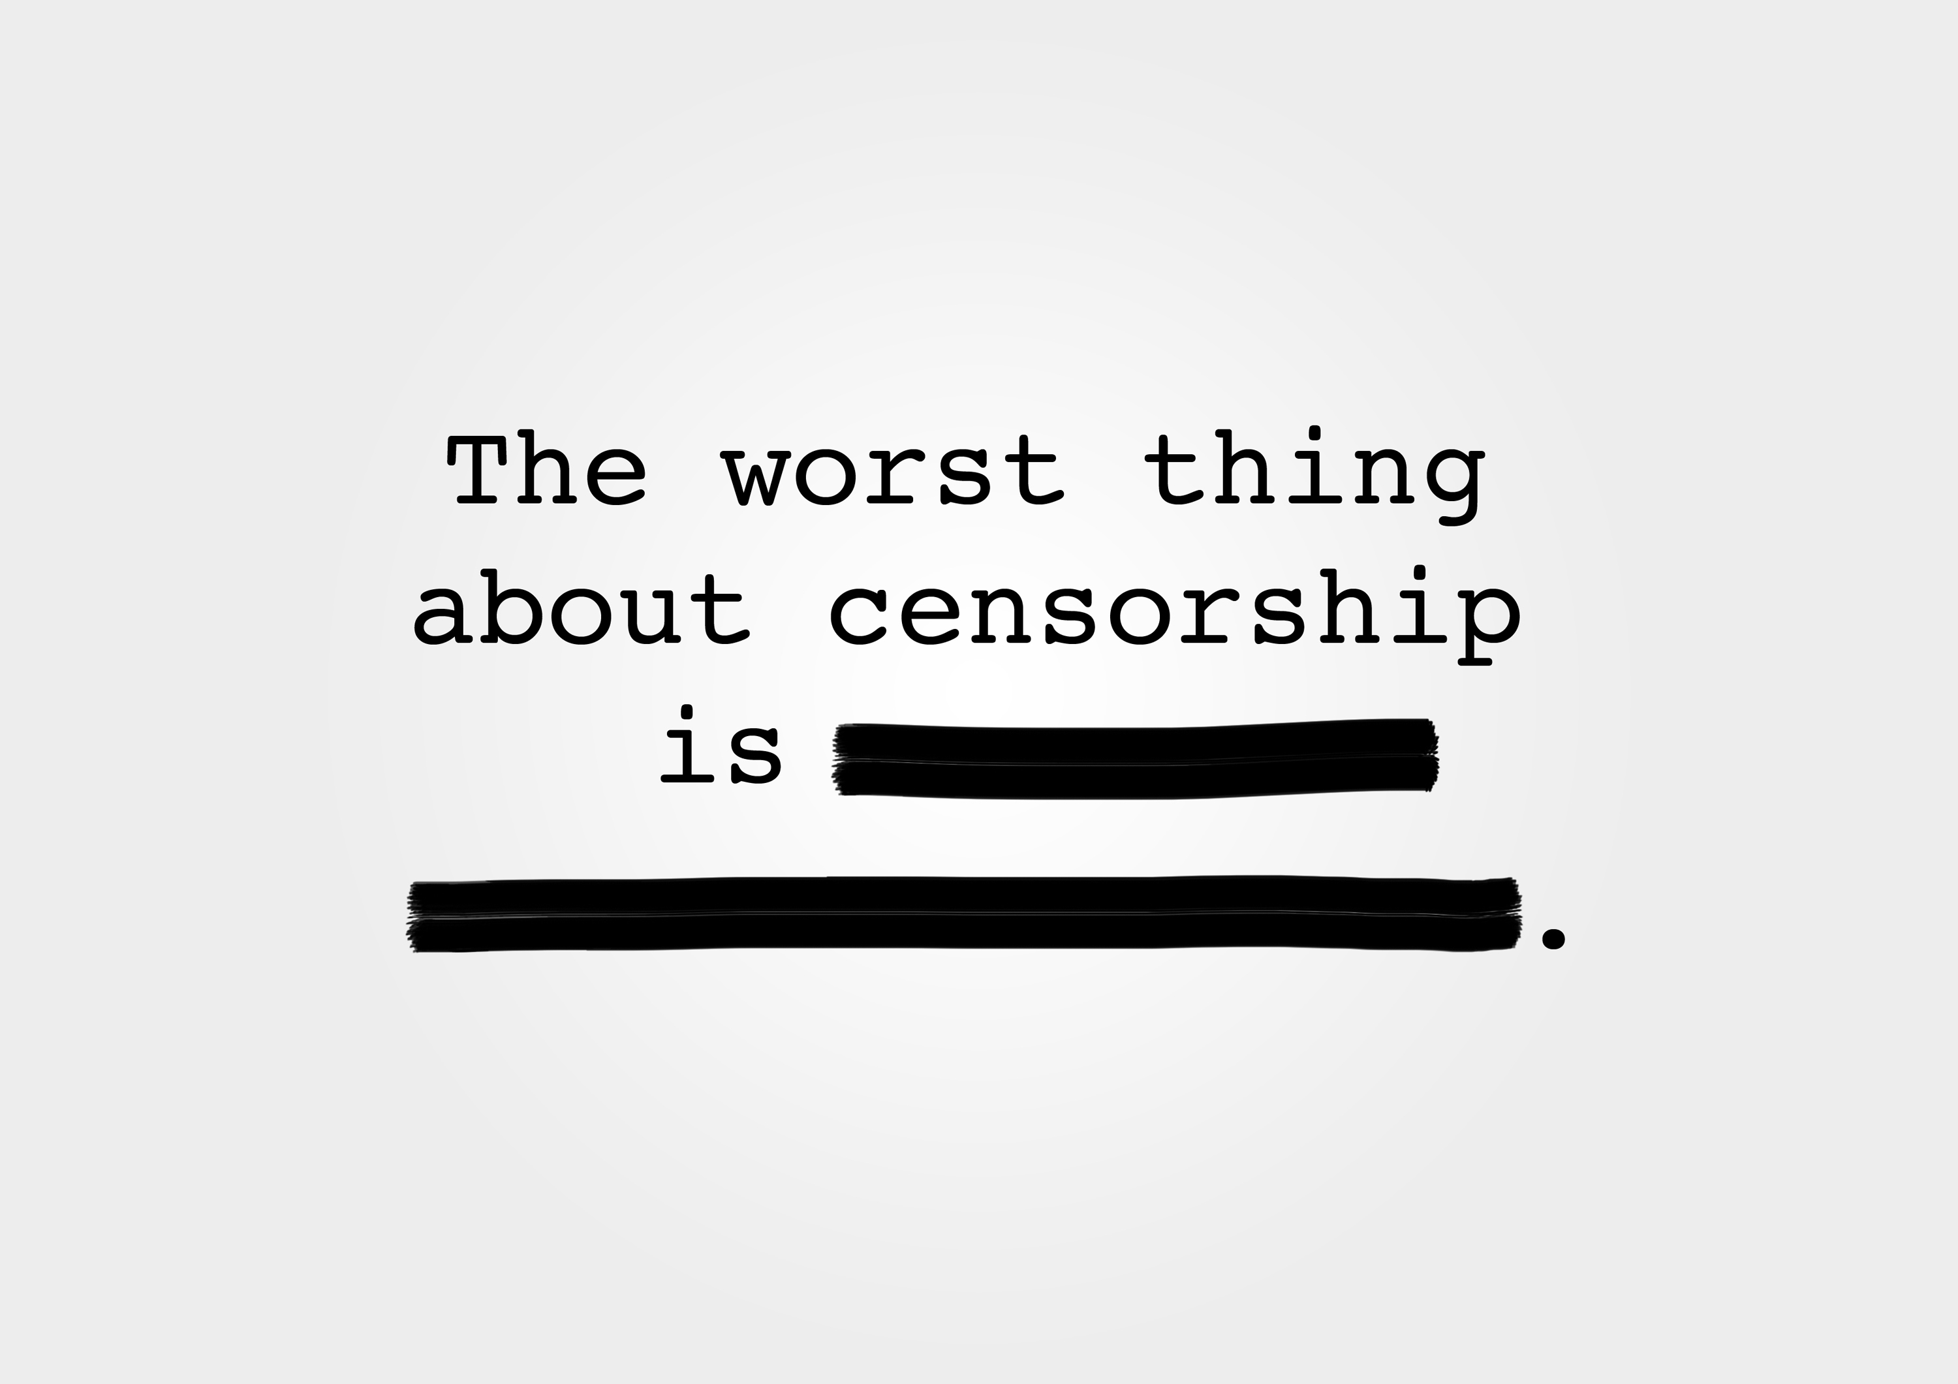
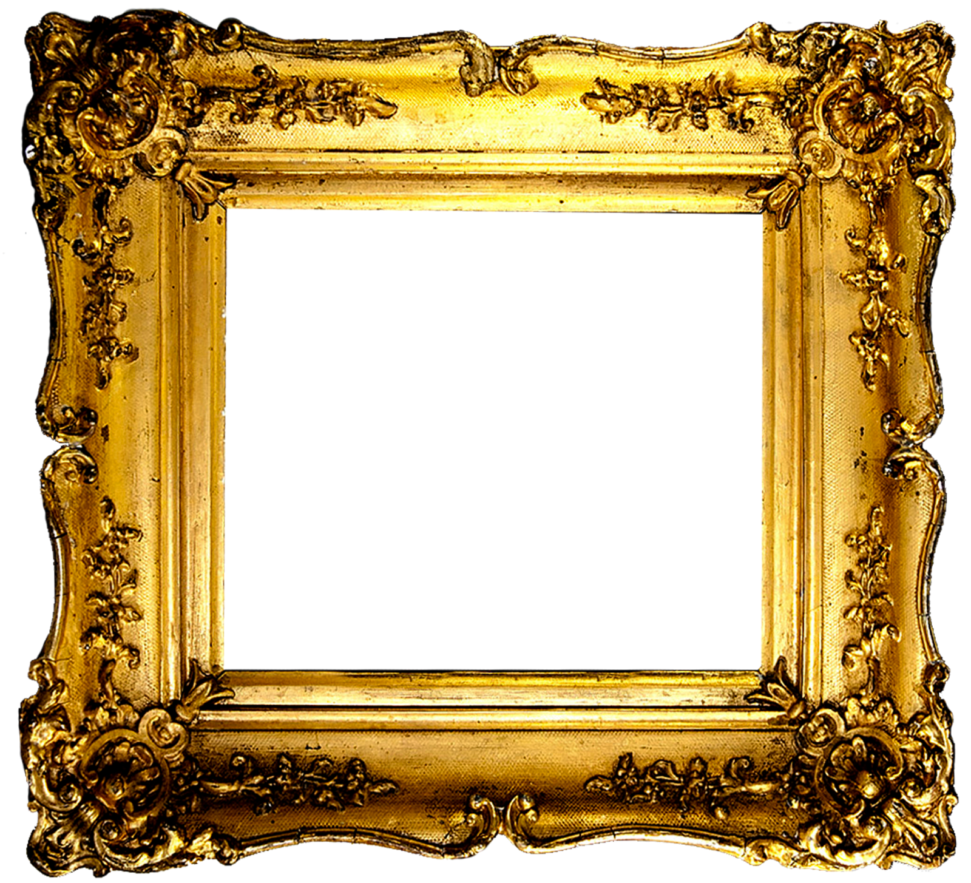
These Governments create:
  Censorship
  Self censorship
But they can't kill the search for freedom of speech.
Notes:
These drives to censorship of the media, self-censorship of journalists and the imposition of laws that prevent a proper communications process, with the false promise of eliminating the power of the elites and giving voice to those who do not have one. These are the main threats to free, independent and irreverent thinking. I believe it will be difficult if not impossible for these authoritative powers to silence the power of communication and information that can be amassed through social media.

Slide 6

What Democracy Demands?
It demands transparency from the government and the citizens…
PLUS…
Freedom to dream, share, and ….be diverse, so
Democracy demands FREE MEDIA
Notes:
An interconnected world allows us to dream, understand and share opinions and experiences that affect our daily life immediately and without censorship. Even in those countries with limited freedom, the events that impact the life of their people are told through different channels that are willing to spread them. It becomes impossible to conceal the reality of its inhabitants.
However, there is still a long way to go in today´s information world if we want to guarantee free, independent and irreverent forms of expression. We need a solid value structure that will defend the transparency of what those who govern and are being governed do.

Slide 7
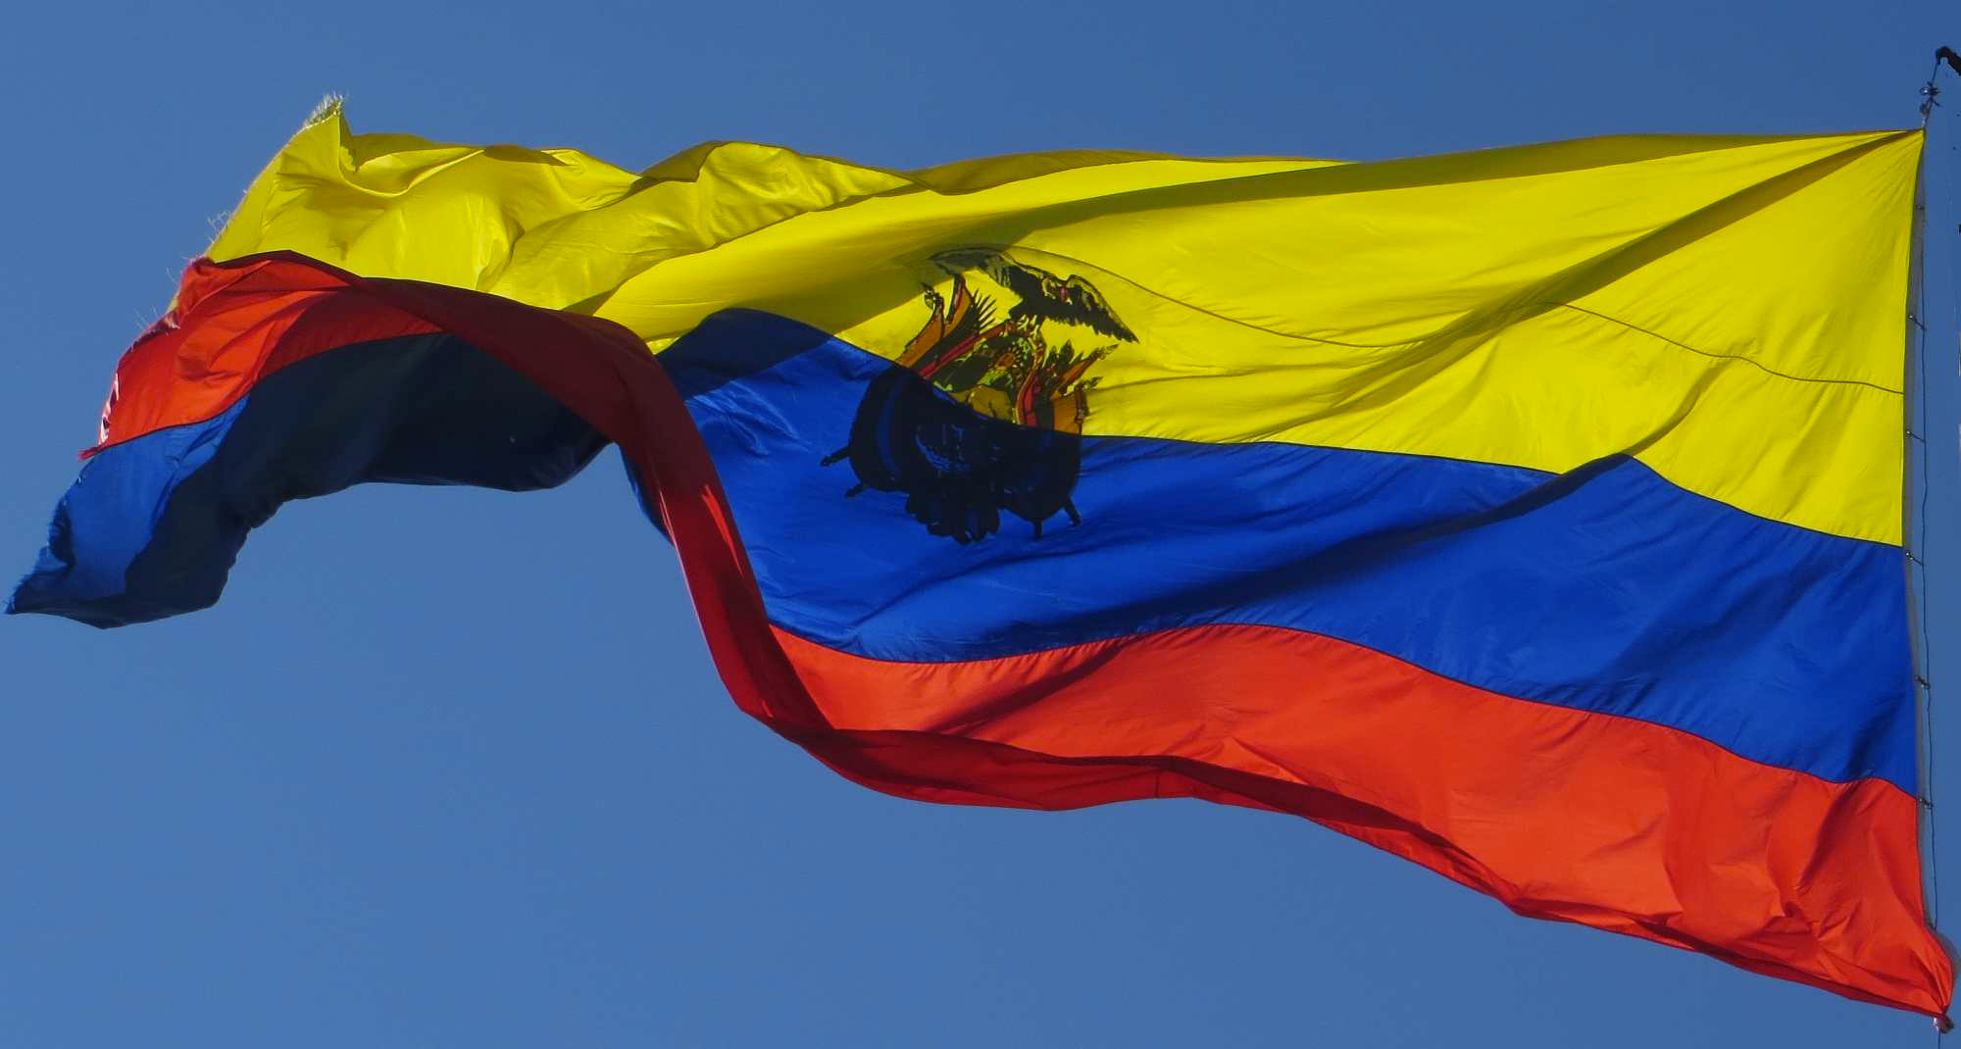
The GREAT paradox
The Ecuadorian Constitution and the Communications Law recognize freedom of expression and information.
But Correa’s regime… self proclaimed as the government of
“clean hands, lucid minds and ardent hearts”
has eliminated
REAL free expression.
Notes:
For this reason, we believe that free access to public information strengthens its citizens and communities. It is a paradox that the new Communications Law which recognizes “the right to communications including freedom of expression, information and equal access to communication technologies as well as the right of citizens to learn about the decisions that affects them” and that was enacted by a government that initially promised an ethical revolution that will require an intimate relationship with its people and change based on Manos limpias, mentes lucidas y corazones ardientes, has eliminated the right of its citizens to freely express themselves; denying them a basic provision of democracy.

Slide 8
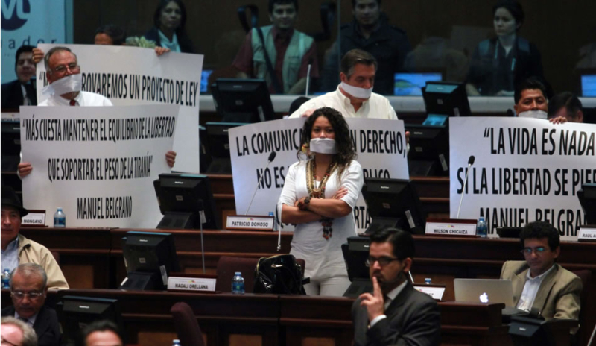
The communications or Gag Law in Ecuador
  Approved on June 25th 2013 & enforced as of January 2014.
  Approval process full of irregularities
The Ecuadorian Constitution and the Communications Law recognize freedom of expression and information.
But Correa’s regime… self proclaimed as the government of “clean hands, lucid minds and ardent hearts” has eliminated REAL free expression.
Opposition members of the Assembly protest against the approval.
Notes:
Important organizations such as the Interamerican Press Association (IAPA), the Ecuadorian Association of Newspaper Editors (AEDEP), and the World Association of Newspapers (WAN) have analyzed the impact that the new Communications Law has had, and I would like to share their findings with you.

Slide 9

What is the Communications Law?
It converts communications into a public service such as water, energy or sewage.
Therefore, information, and the right to express ideas becomes a service to be controlled by the government.
The proposal was signed into law by the Assembly under the cover of a national holiday.
Notes:
The National Asembly ignored the warnings from UN and OAS rapporteursThe proposal was signed into under the cover of a major National Holiday

Slide 10
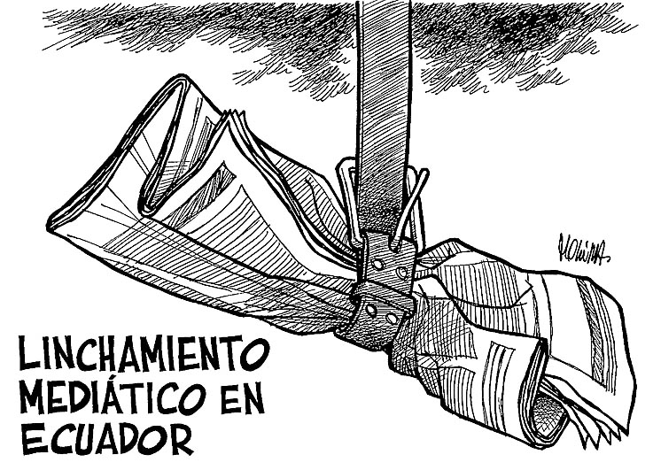
It establishes “the media lynching” or “linchamiento mediático”, when media publishes something that might be controversial for a person or group of people.

Slide 11
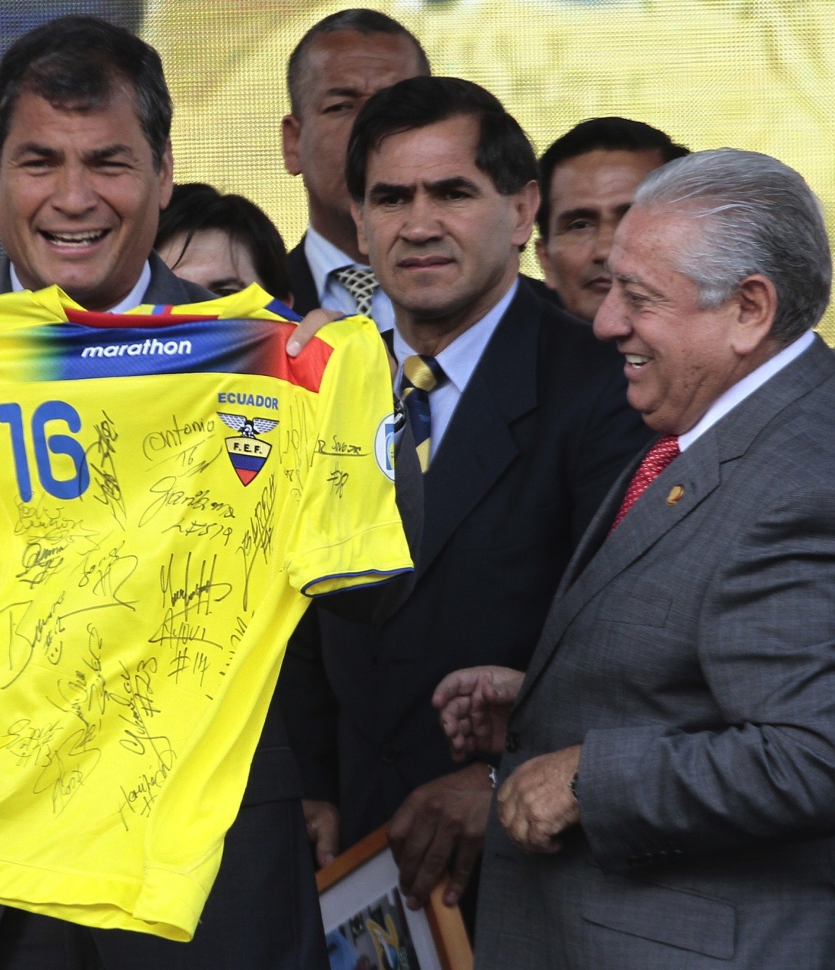
In the first case of “linchamiento mediático” after the law was issued, TELEAMAZONAS was penalized because of a complaint filled by the former president of the National Soccer Federation (FEF) forcing the network to appologise for several comments made during a sports program.
The former president is currently in jail for allegations related with the FIFA scandal.

Slide 12

It forces de-funding of the private and independent media.
It encourages the divestment and limits new investments on the media sector.
It leads the government to increase its share of media outlets.
It helps government to eventually take control of all media.

Slide 13
It established a special inquisitorial Court, the SECOM or SUPERCOM, a Communications court with special jurisdictions not governed by the Supreme Court and Ecuador´s judicial system.
It established the CORDICOM , a control agency that imposes all media to publish content deemed by the government as of national interest.

Slide 14
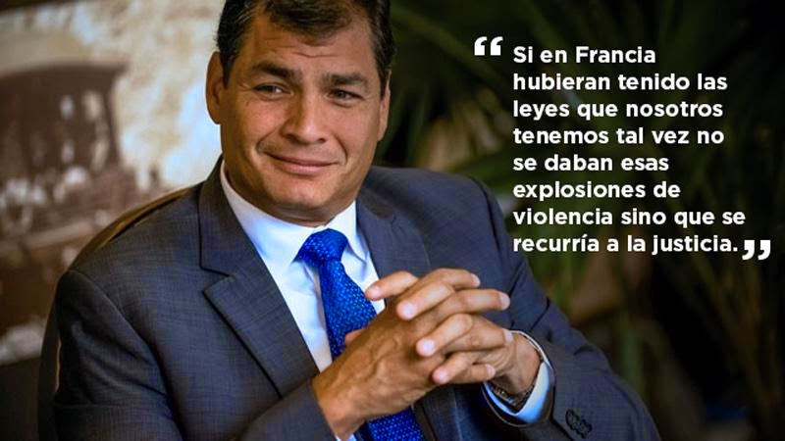
“If in France they would have had the laws we currently have, maybe there wouldn´t being those violent reactions, but they would have gone to justice first.”
Referring to the Charlie Hebdo killings.
It sanctions for publishing content that could be upsetting, opposing or not aligned with the government´s point of view.

Slide 15
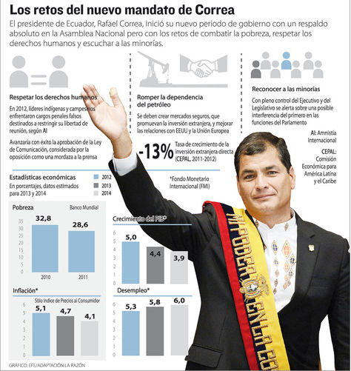
The law erases the line between what is “communication” and what is just simple official “propaganda.”
For example, the image, voice and videos related to President Correa are protected by copyright laws. Therefore the use of those could be easily “censored”.

Slide 16
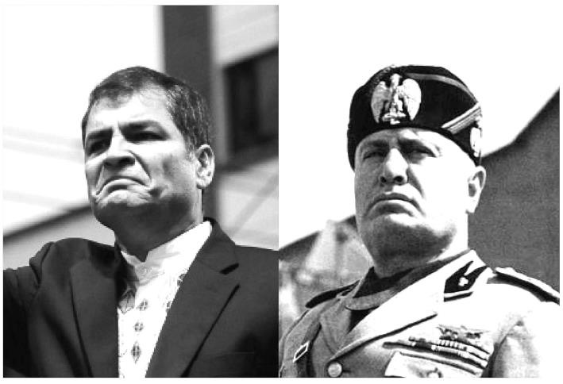
In a “propaganda apparatus” the main issue is to take care of the image of the strongman. Those who seek the opposite, should be punished.

Slide 17
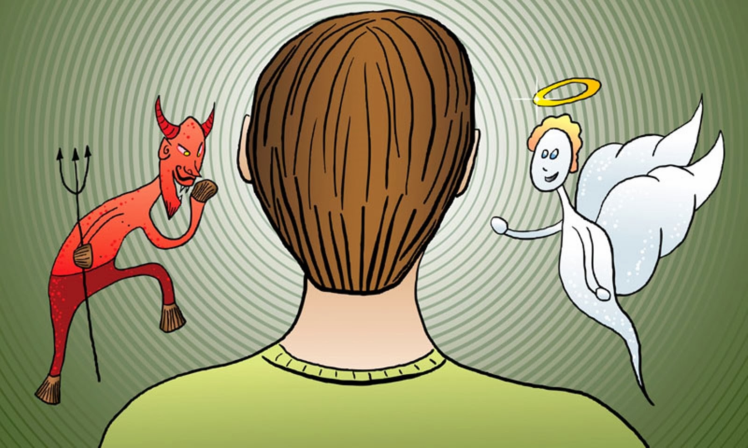
The Communications Law, imposes a code of conduct inspired by the moral views of the leader and doesn’t respect the own values of the media.
And the sanctions come from many different reasons according to the criteria of the plaintiff and the ruling judge (who most of the time are the “same”)

Slide 18
The Communications law and its ruling are
subjective, discriminatory and arbitrary
frequently invoking contrived semiological interpretations produced by the CORDICOM.
Sanctions are disproportionate:
  - exaggerated pecuniary fines
  - awkward rectifications
  - admonishments

Slide 19

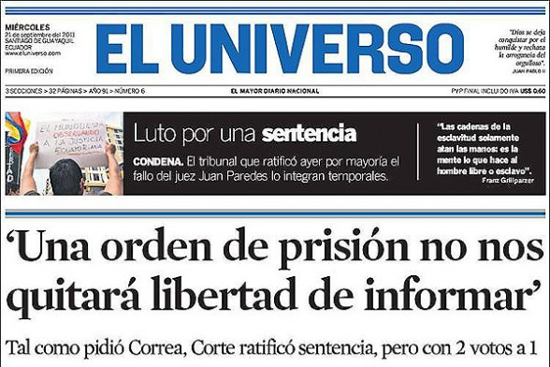
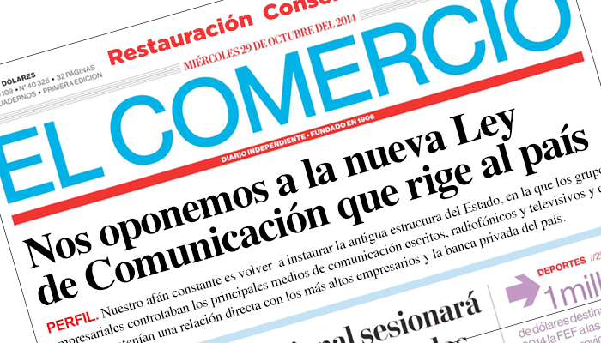
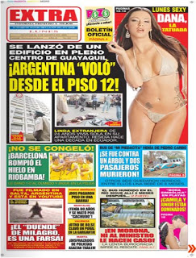

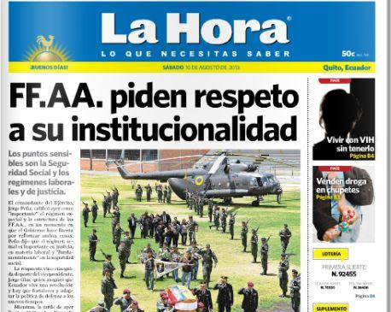
Independent Media has been silenced, santioned, fined or forced to shut-down

Slide 20
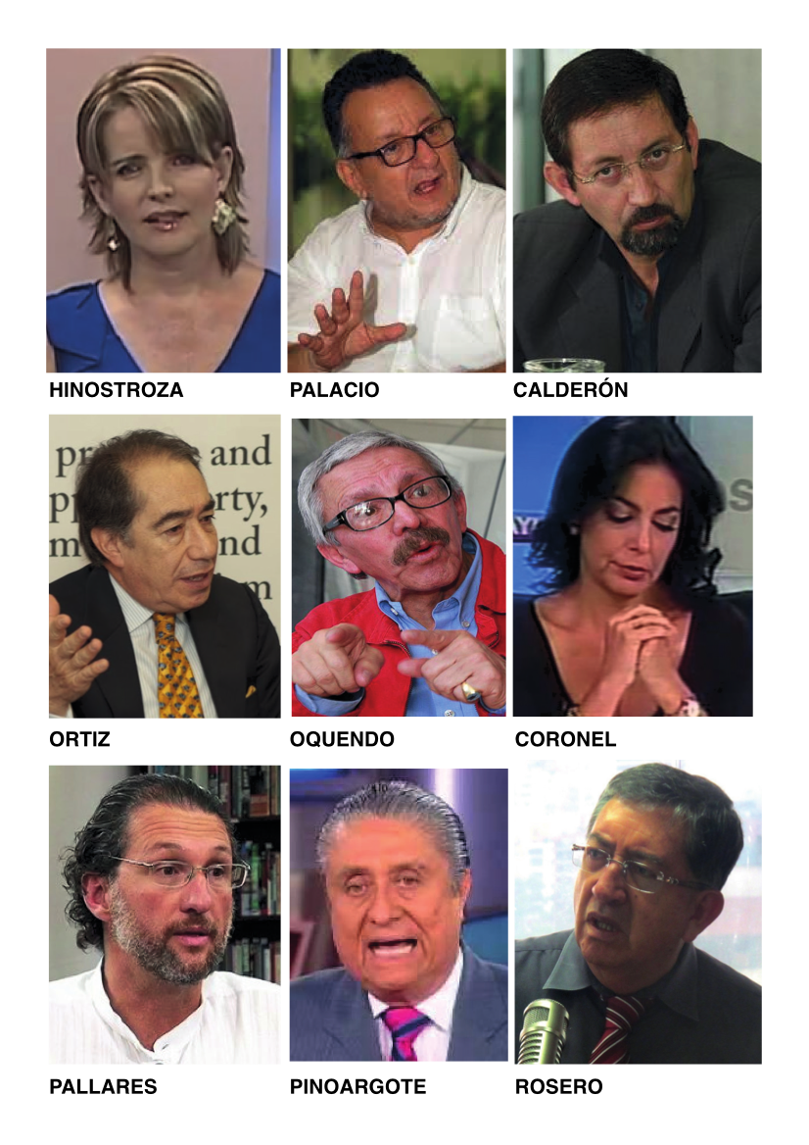
Journalists have been attacked, insulted & persecuted
But independent journalists do not have the same right as citizens to complain about the attacks received through the government´s controlled media.
Government media is shielded from the sanctions of the law.

Slide 21
THE RIGHT TO REPLY…
What the law state?
Art. 24.- The right to reply.- Any person or group that has been mentioned through a media outlet in a way that affects its dignity, honor or reputation has the right to ask that same media outlet to publish its reply in the same space, page and section in the printed media or in the same program or audio visual outlet , no longer than 72 hours since the request was made.

Slide 22

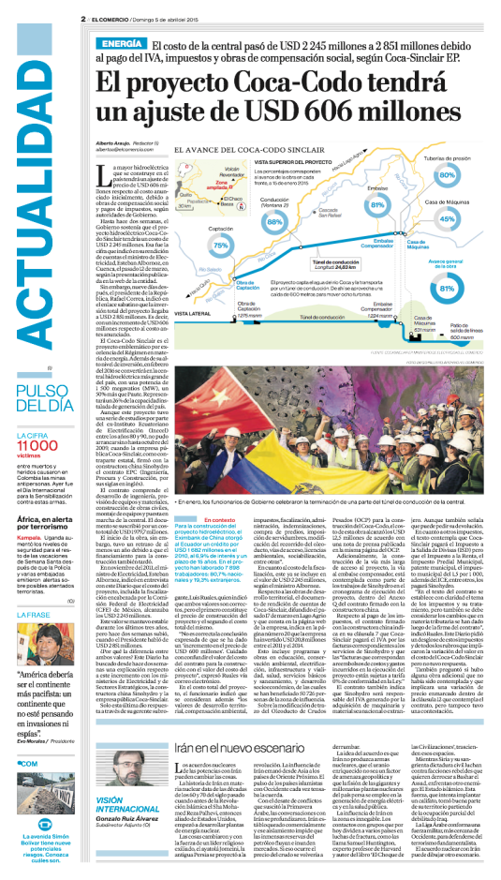
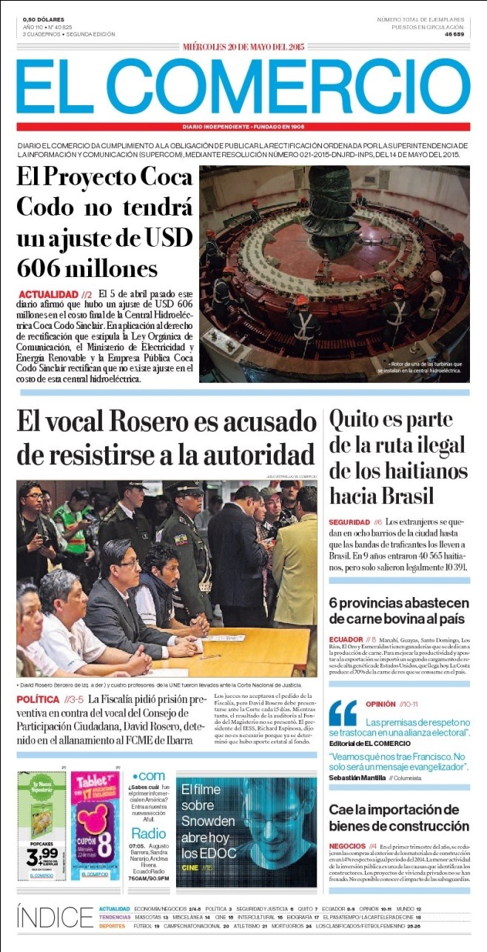
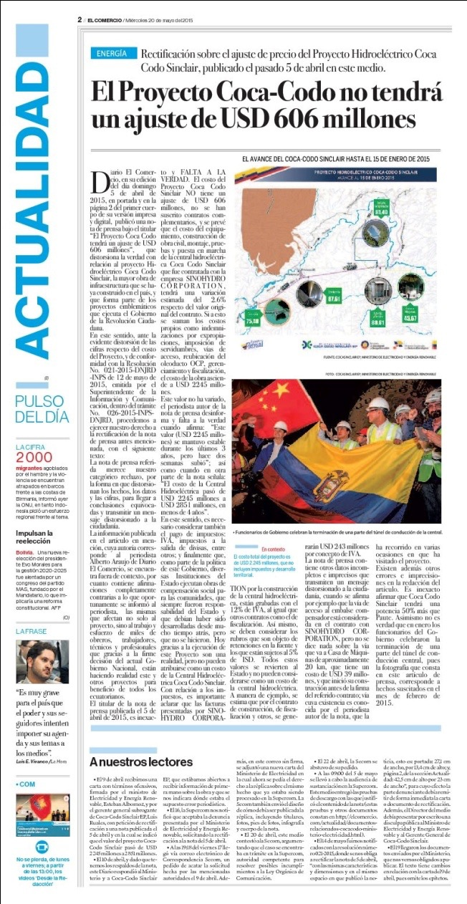
How government changes reality
The original publication:
What the “Cordicom” ordered:
Notes:
-$600 millon the adjustment in Coca-Codo ( one of the main Hidraulic Projects) , was the headline of El Comercio.
- The Project Coca Codo, will not have an adjustment of $600 millon, order the Cordicom

Slide 23
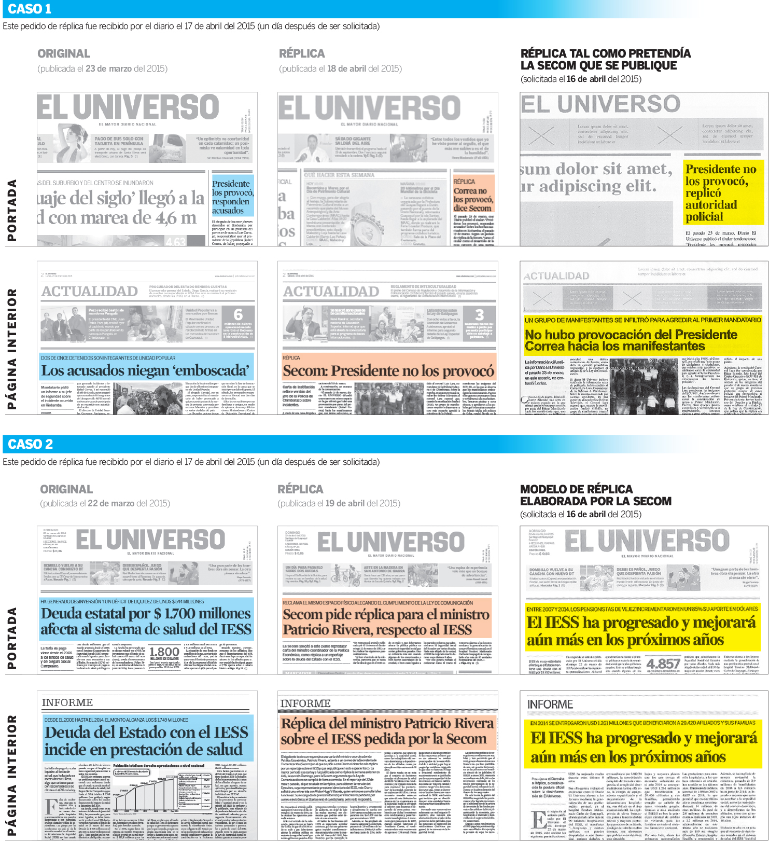
Headlines are REQUIRED to be modified based on governments point of view:
And……. EL UNIVERSO was punished because didn´t accept to print this piece designed and writen by government officials
Notes:
-$ 1.700 billon of Government debt affects health system from the Social Security was the original headline from El Univeso
- Social Security has progressed and will improve more in the following years Order the CORDICOM to print .

Slide 24
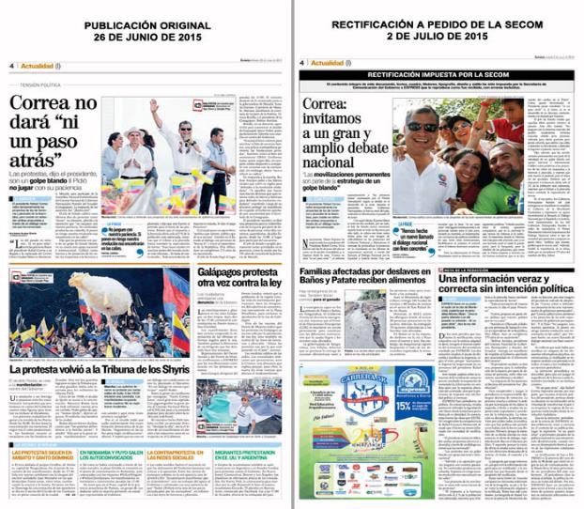
Expreso, forced to talk like Correa
Notes:
Correa will not give a step back, was the headline from Expreso
CORDICOM order to print: Correa: we invite to a great and ample national debate

Slide 25
La Hora, forced to print oficial propaganda as news.
Notes:
After a proposal to change the law related with inheritance tax, La Hora print this headline: Unrest about new inheritance tax.
The Cordicom order to print: Inheritance Tax: a way to redistribute wealth

Slide 26
In Conclusion:
THE COMMUNICATION LAW
Promotes the media monopoly from the government;
IS regressive, discriminatory; repressive;
CENSORS, encourages self-censorship for journalists and media outlets in general.
ELIMINATES investigative journalism.
IMPOSES one and ONLY truth: the official speech.
SILENCES the critics and buries the corruption allegations.
Violates democracy

Slide 27
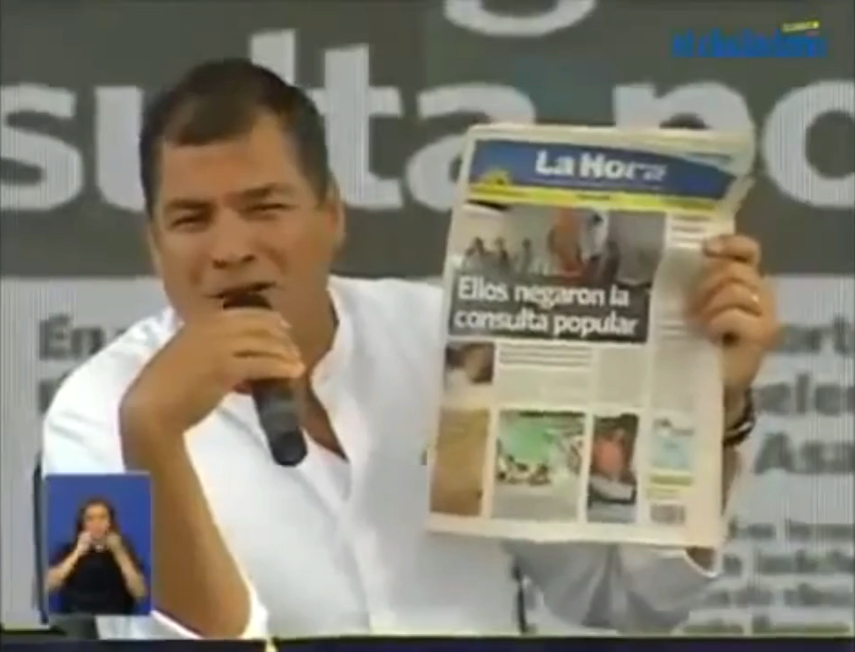

Slide 28
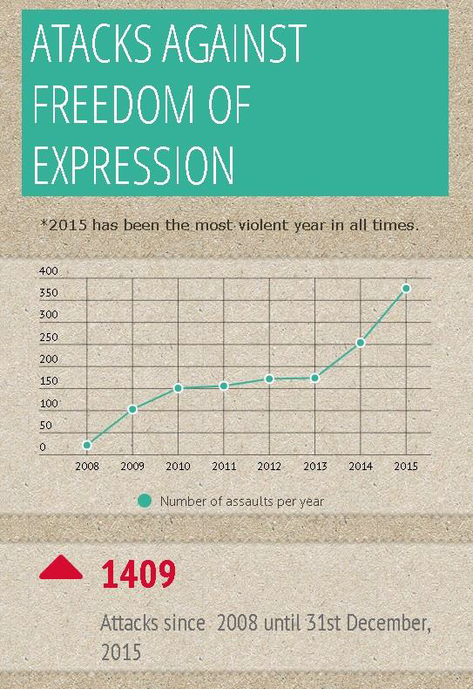
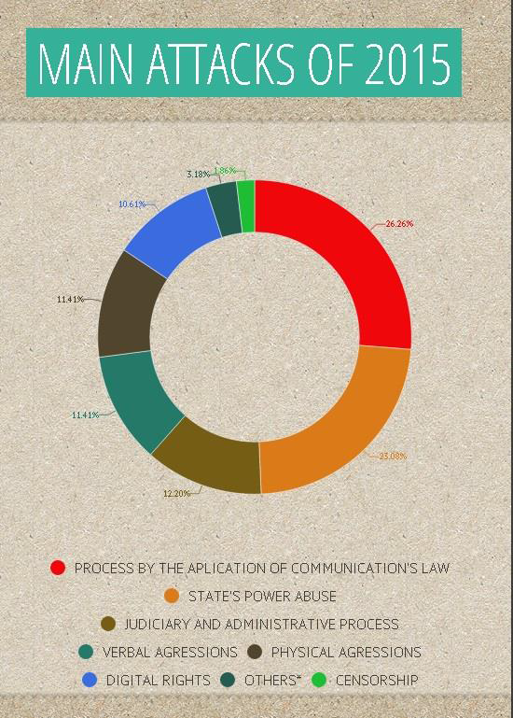
Source: FUNDAMEDIOS
Notes:
Some facts: Since 2008, until December 2015, Ecuador has faced 1409 attacks against freedom of expression. Since the promulgation of the law (2013), it’s a growing trend in the number of aggressions : Almost 60% of this aggressions can be related to the application of the Communications law

Slide 29
What the near future offers…
THE FACTS:
Next presidential and national assembly elections to be held on February 2017
Authoritarian and populist government
President Correa’s decision not to run for office this time.
Both, opposition and government parties divided
Independent information and freedom of expression reduced to a minimum
All powers controlled by the Government
FUTURE LOOKS UNCERTAIN
Notes:
As we can see Ecuador is facing serious political and economic problems. The Communications Law and the policies of an authoritarian, populist government have given rise to a very complex outlook for the 2017 elections. President Rafael Correa has mentioned that he will NOT run for reelection and that his decision has been taken and informed to the National Assembly. He has even requested that the constitutional amendment calling for indefinite re-election be removed; however, some government aligned groups, in fear of losing control and power are still pushing for this amendment to be approved in spite of violating the current electoral laws.
The opposition is divided as well as the ruling party. Correa’s egotism has prevented the rise of possible successors even from his own party.
Independent, unbiased information has been reduced to a minimum and the government currently controls every power of society. The economy has been heavily hit by the decline in oil prices and the people are frustrated.
With this outlook the future is extremely uncertain.

Slide 30
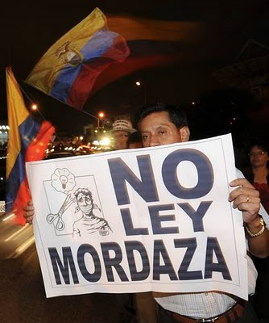
THE NEW GOVERNMENT
TO BE ELECTED ON FEBRUARY 2017,
SHOULD REPEAL THE COMMUNICATIONS LAW
DEMOCRACY AND FREE SPEACH WOULD PREVAIL!!!
Notes:
However, the night is never as dark as when dawn approaches. We hope that God willing the citizens of Ecuador drive the profound change that the country requires in the 2017 elections; choosing leaders that will repeal this law that threatens a basic human right and principle of democracy. The right to freedom of expression and will restore Freedom in our country
Thank You

