Slide 1
AD BLOCKING & the End of Advertising 1.0
Ben Shaw
Director of Global Advisory
WAN-IFRA Frankfurt

Slide 2
A Bit About Me
WAN-IFRA: Director Global Advisory
Focused on providing independent advice on digital strategy & organizational change to our members
Previously: CTO of Shaw Media
Over 100 print and digital products in the MidWest of the USA
12 Dailies/ 35 Weeklies

Slide 3
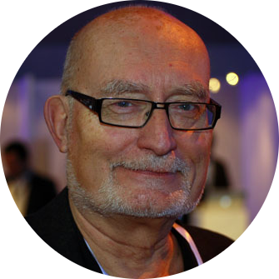
Insights that Transform your Business
KALLE JUNGKVIST Digital Transformation Sweden
VIVIAN SCHILLER
Digital Strategy and Transformation USA
BEN SHAW Digital Strategy USA/Germany
GREGOR WALLER Digital and Paid Content Germany
JOHNNY RYAN Design Thinking and Digital Transformation
Ireland
FRÉDÉRIQUE LANCIEN New Business Strategies France
FERGUS BELL Social Media and Digital Newgathering United Kingdom
HÅKAN HELANDER Newsroom Organisation
and Production Sweden
ANAND SRINIVASAN Pre-Press and Production India
BENJAMÍN MORALES Digital Strategy & New Business Models Puerto Rico
consulting.wan-ifra.org

Slide 4
Agenda
What Is Ad Blocking?
Who Is Ad Blocking?
How Are Companies Reacting?
Industry Priorities
Suggestions For Publishers

Slide 5
How Advertising Is Changing
The first 20 years of online advertising helped fuel the growth of the Internet
But have often been marked by a deterioration of the audience experience.

Slide 6
How Advertising Is Changing
As ad tech companies became more aggressive, the lower readers’ tolerance became.
If ads continue to obscure content, slow websites, pry into data and break the audience’s trust, then big tech will have the opportunity to step in and set the rules

Slide 7
What Is Ad Blocking?

Slide 8
Image Source: PageFair 2015

Slide 9
Image Source: PageFair 2015

Slide 10
Image Source: PageFair 2015

Slide 11
Image Source: PageFair 2015

Slide 13
Now on iOS 9

Slide 14
Who is Ad Blocking?

Slide 15
Global Average for News
10%

Slide 16
Who is Ad Blocking?

Slide 17
Ad Blocking in LATAM
As of Q1 2015:
Mexico: 9.8%
Argentina: 15.4%
Chile: 14.1%
Uruguay: 13.4%
Brazil: 6.2%
Paraguay: 3.5%
Bolivia: 4.0%
Ecuador: 10.1%
Colombia: 9.0%
Venezuela: 4.4%
Trinidad and Tobago: 6.6%
Source: Adobe & PageFair 2015

Slide 18
Who Is Ad Blocking?
Image Source: PageFair 2015

Slide 19
Willingness To See Some Ads
Image Source: PageFair 2015

Slide 20
Repeating The Past?
Publishers are in the same situation now as the music industry was in the early 2000s.
Back then, the music labels, like today’s publishers, were unable to present listeners with an attractive transaction.
The music industry failed to offer digital consumers an attractive alternative to piracy.
As a result, users rebelled and refused to pay for music, and the music industry was forced to accept Apple’s rules.

Slide 21
How Are Companies Reacting?
Do Nothing
Pay To Un-Blocked
Tracking it
Asking Nicely
Asking Firmly
Freemium Model
Tech Escalation

Slide 22
Industry Priorities
1
Improve the overall ad experience for users without ad blockers

Slide 23
Industry Priorities
2
Find ways to encourage users with ad-blockers to agree to be served ads

Slide 24
Example from Germany

Slide 25
Industry Priorities
3
Focus on mobile-ready advertising opportunities that diversify online

Slide 26
A Unique Opportunity
Publishers’ most precious asset is the trust and goodwill of their audience.
If publishers allow the technology platform companies to become the gatekeepers of news content — as Apple became for music
Then they will find themselves in the role of commodity producers rather than trusted brands.

Slide 27
What is WAN-IFRA Doing?

Slide 28
What is WAN-IFRA Doing?
Publisher Roundtables in London, Dublin and Hamburg
Surveyed Our Global Membership
Resource Center Launched at: http://www.wan-ifra.org/microsites/ad-blocking
International Task Force Created To Share Best Practice and Draft Publisher’s Response.

Slide 29
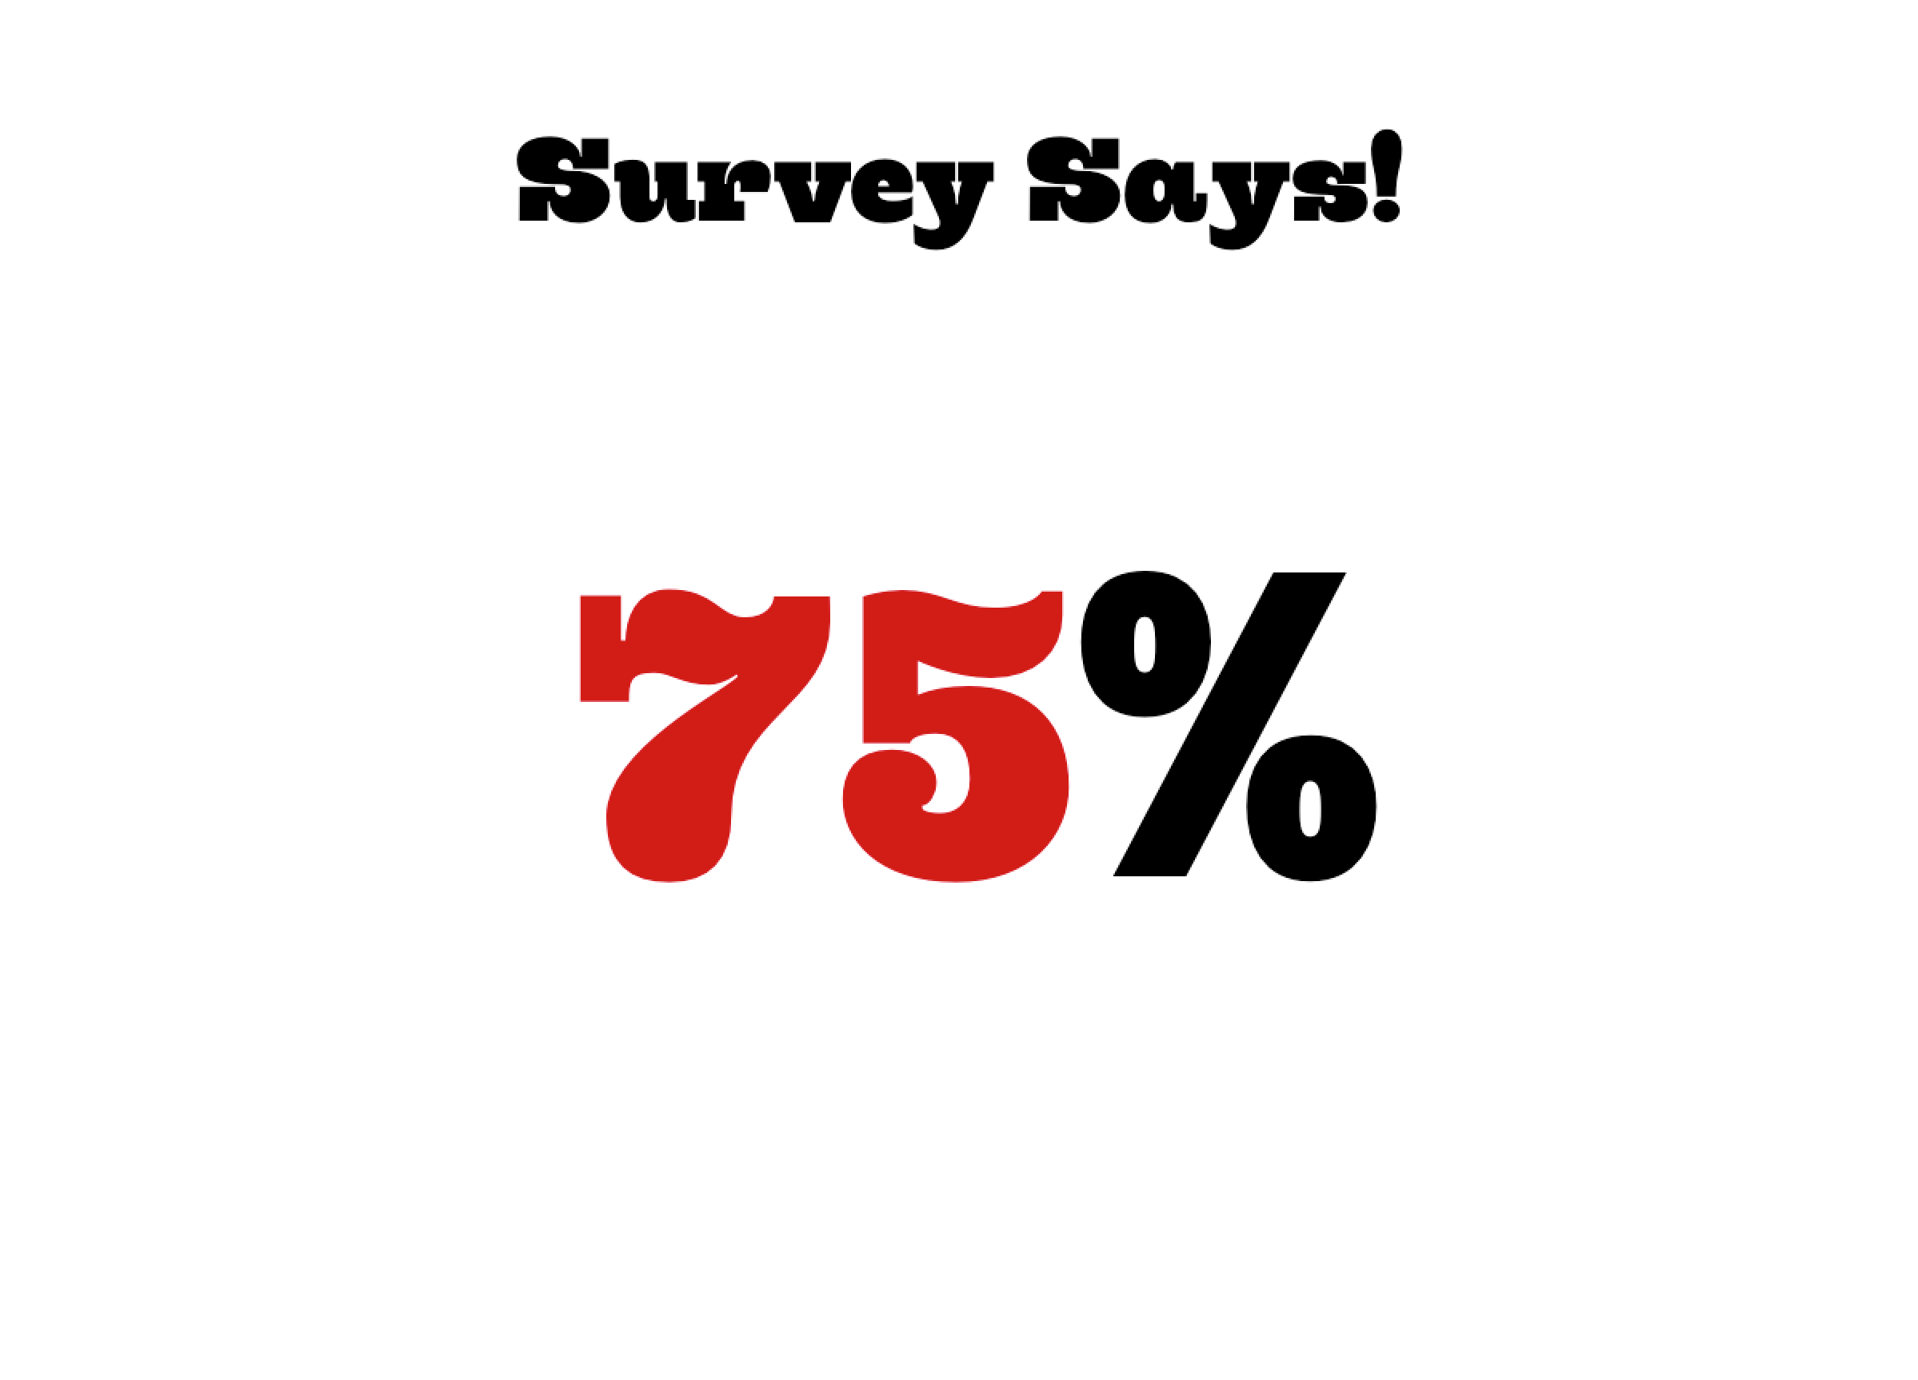
Survey Says!
75%
Notes:
Either Extremely or Very concerned about ad blocking

Slide 30
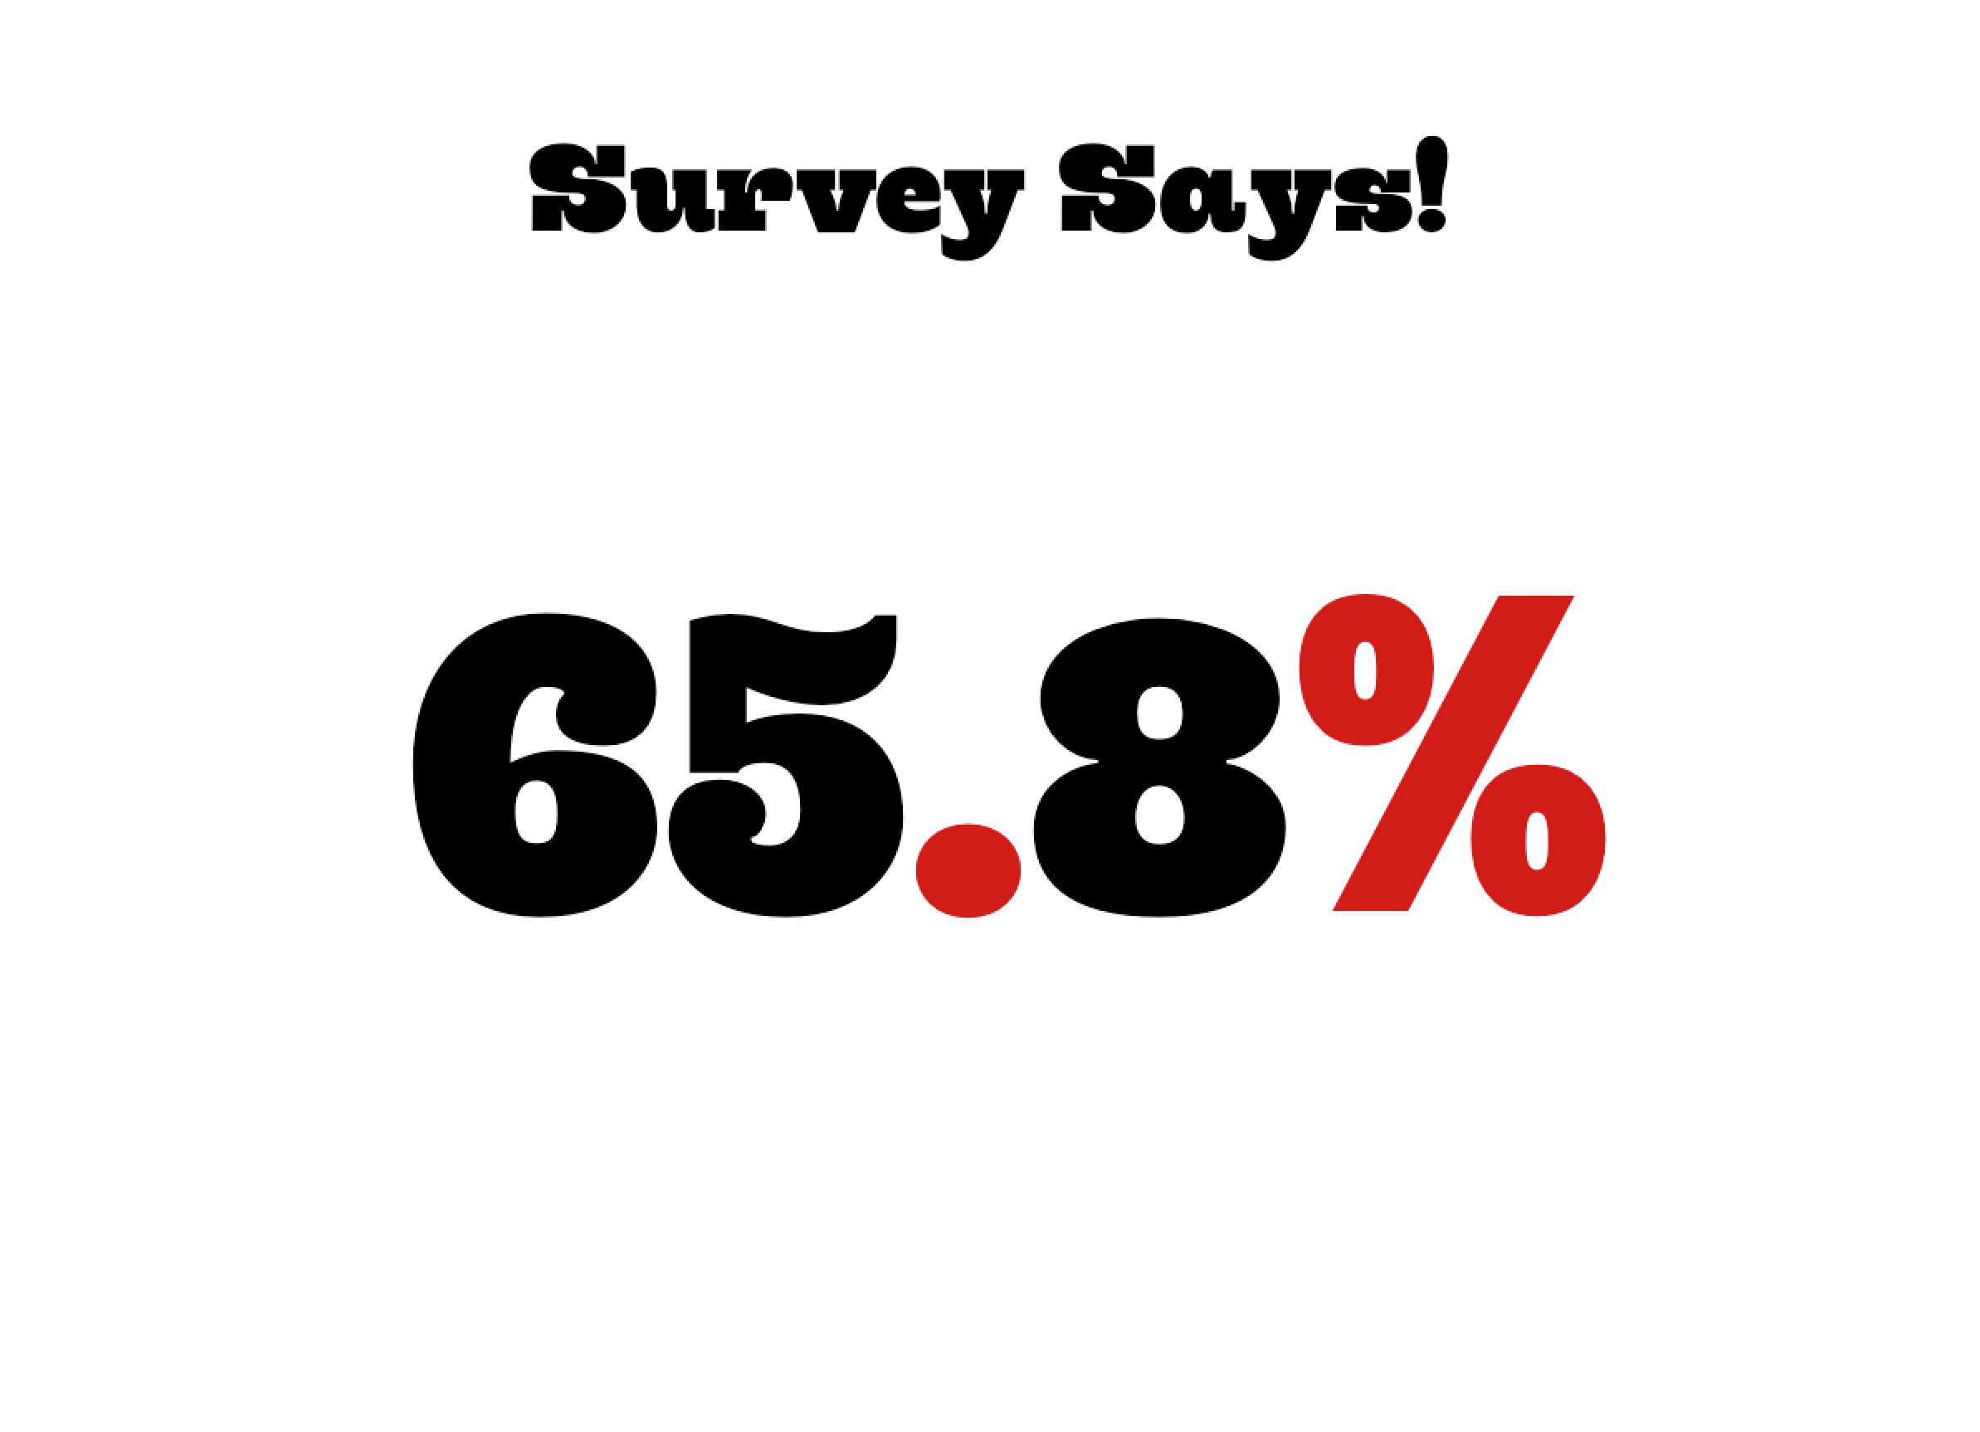
Survey Says!
65.8%
Notes:
Say that between 50-75% of their digital revenue is based on display advertising

Slide 31
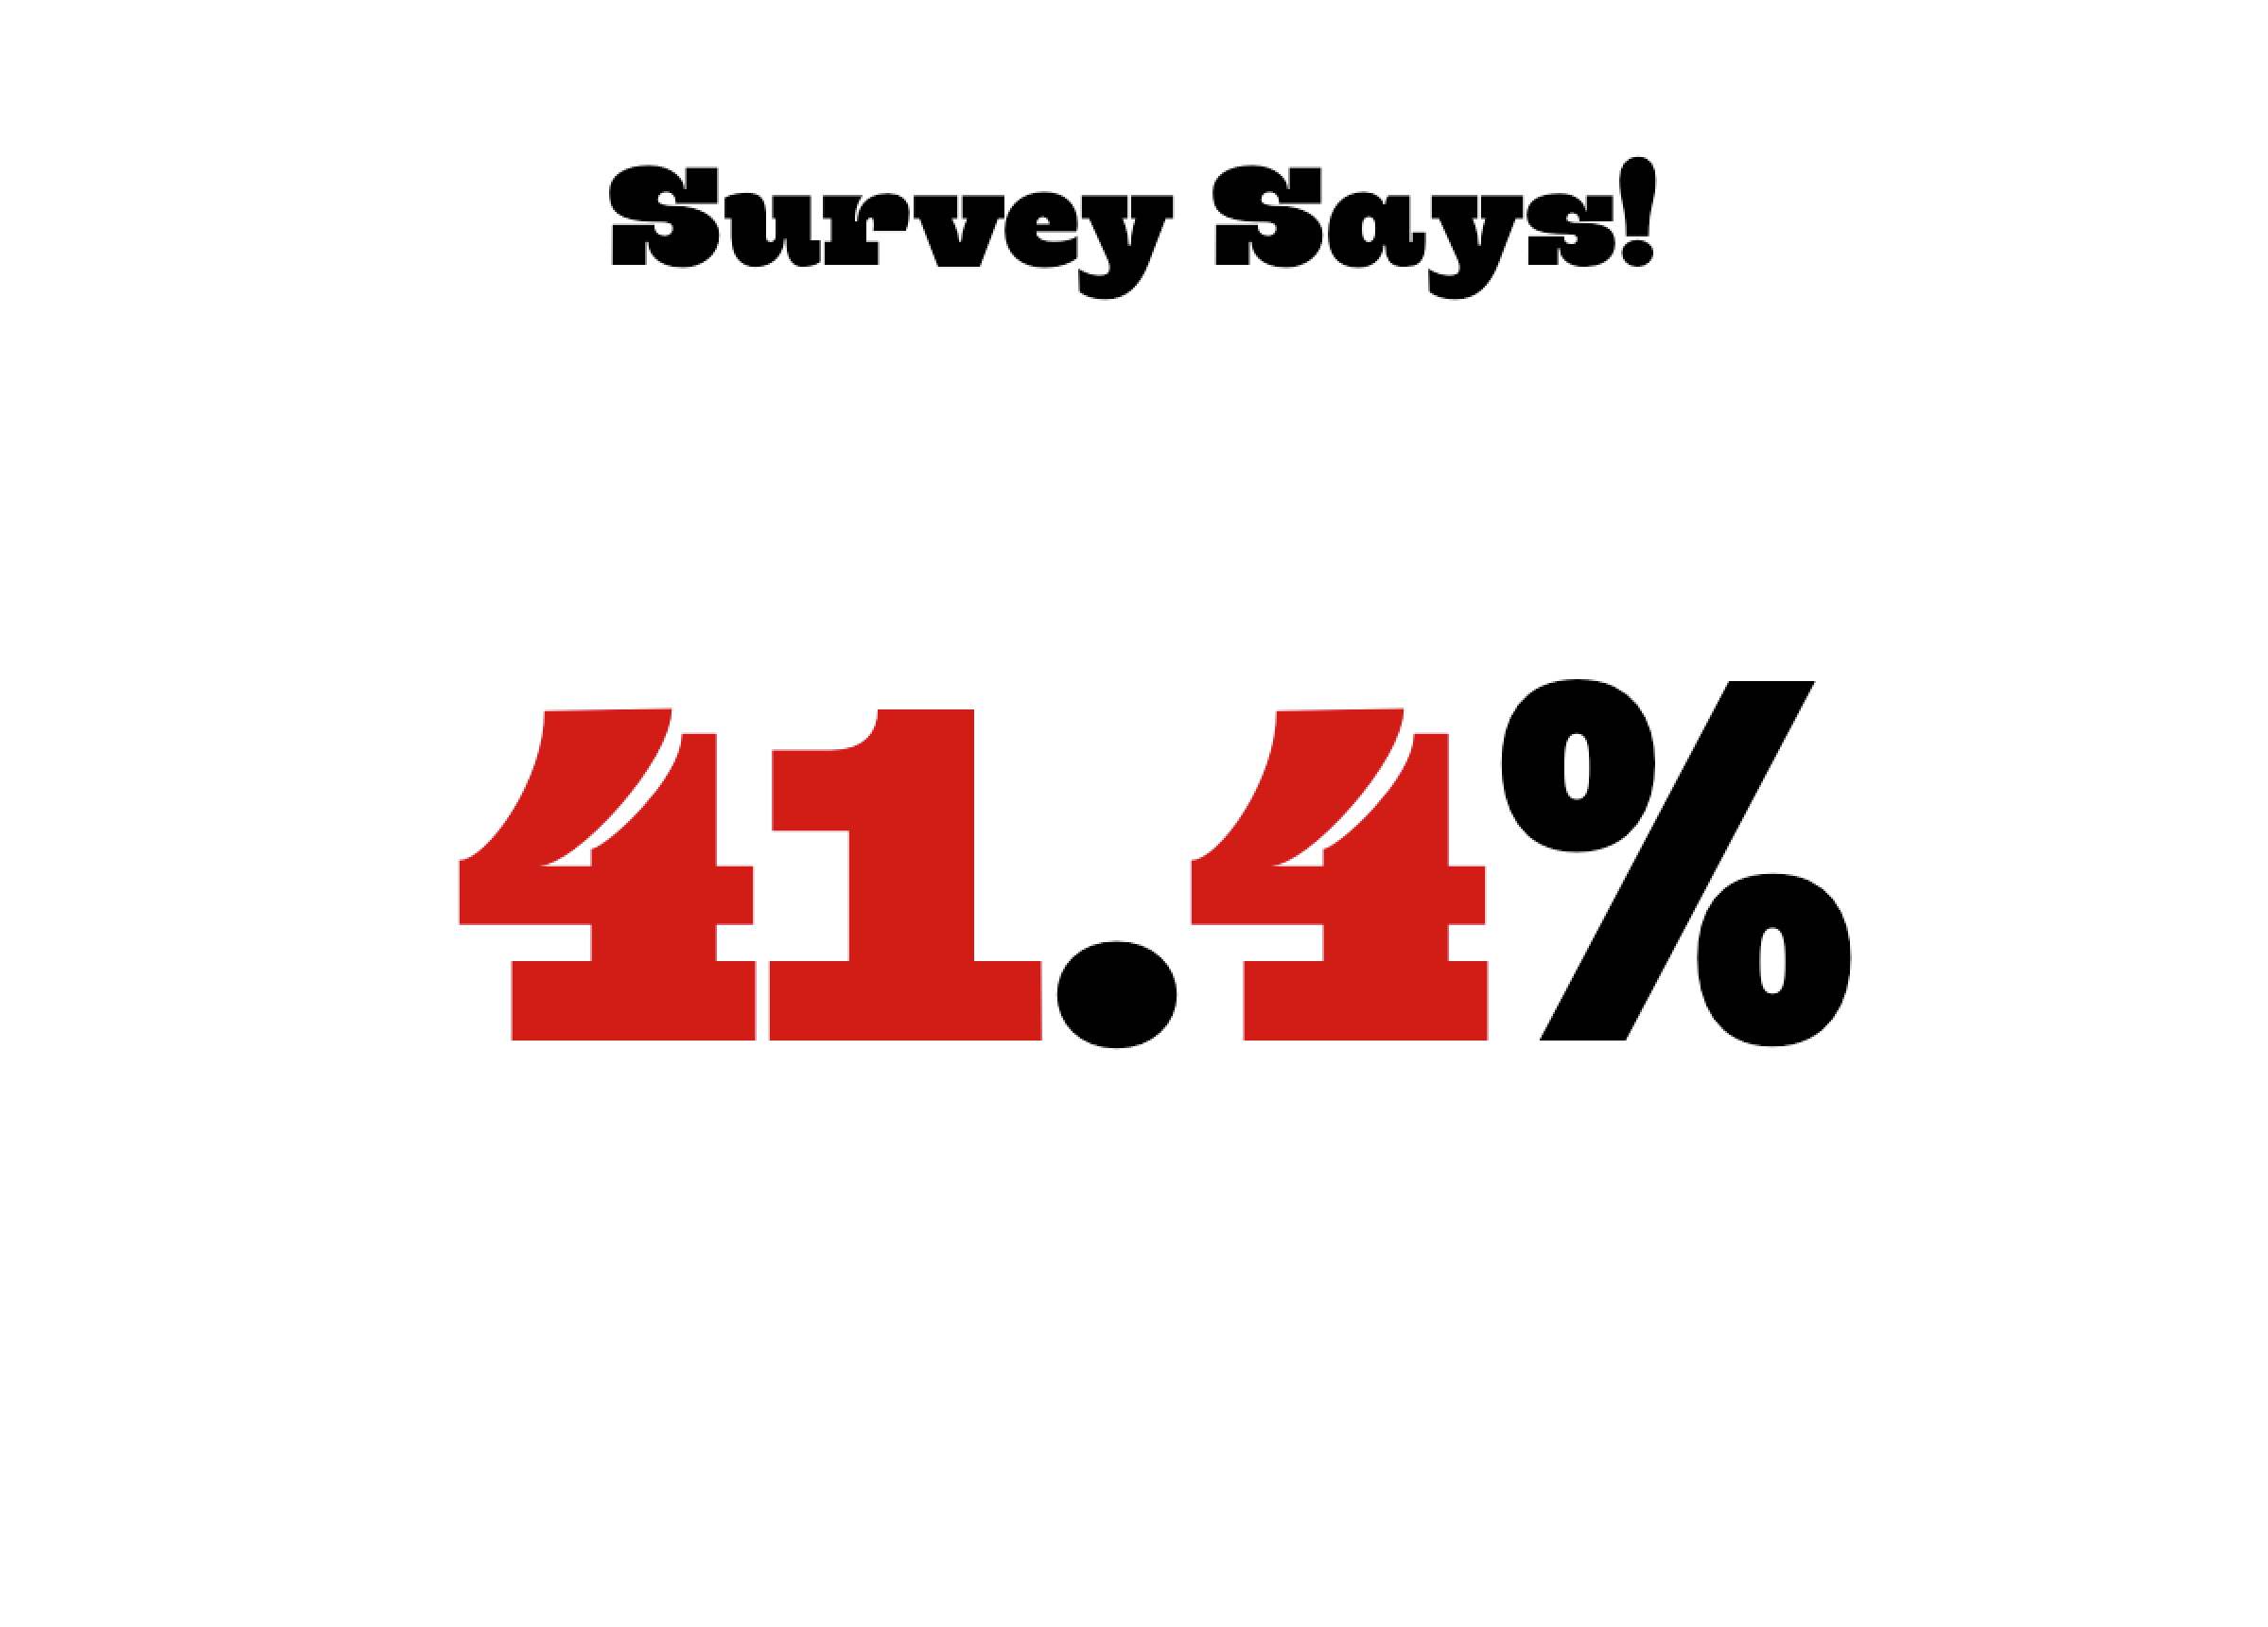
Survey Says!
41.4%
Notes:
Have noticed a change in the performance of their ads already.

Slide 32
A Unique Opportunity
Publishers have an opportunity to redefine how advertising works online and save the mechanism of advertising that supports content on the open web. Publishers, not platforms, must take the lead.

Slide 33
Advertising 1.0 emerged from a process of experimentation for short-term gain
That often produced unintended negative consequences, but occasionally stumbling upon enduring formats.
Advertising 2.0 must be different
We need guiding principles that will shape the experience that users enjoy on publishers’ sites in the future.

Slide 34
Suggestions for LATAM Publishers
Begin Tracking It
Consider ways you can experiment with users who are already ad blocking
Focus Diversifying Revenues On Branded Content and Other Mobile- Friendly Options
Focus on great Mobile Experience
Get involved!

Slide 35
Thanks!
Ben Shaw
Director of Global Advisory
WAN-IFRA Frankfurt
Ben.shaw@wan-ifra.org

